Slide 1


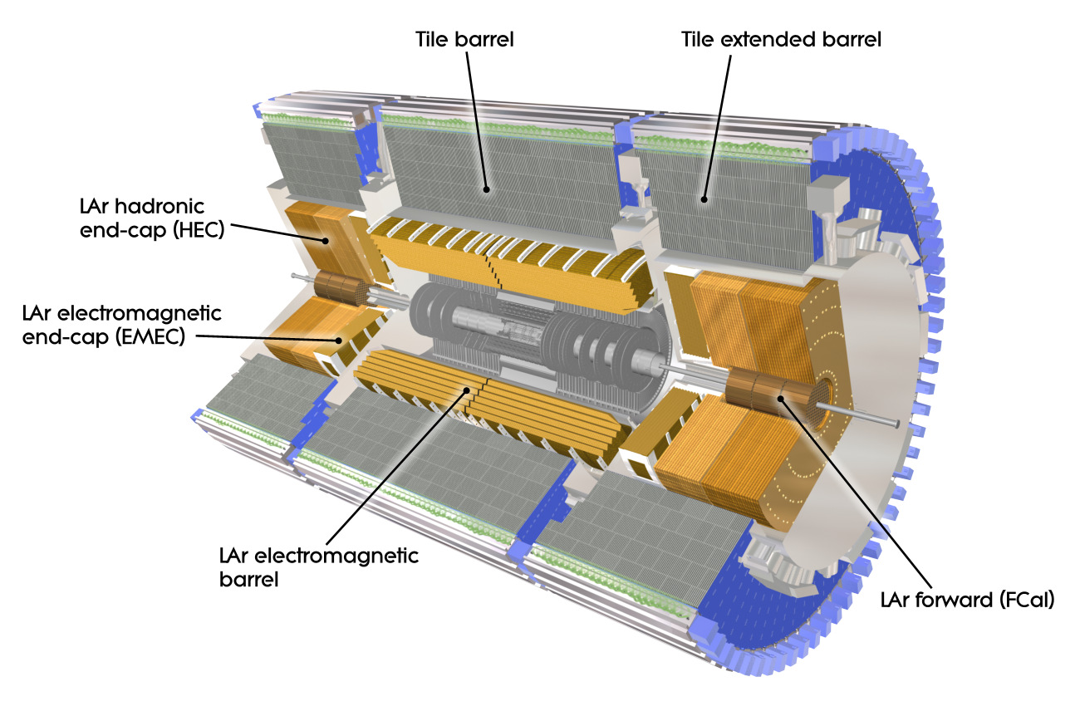
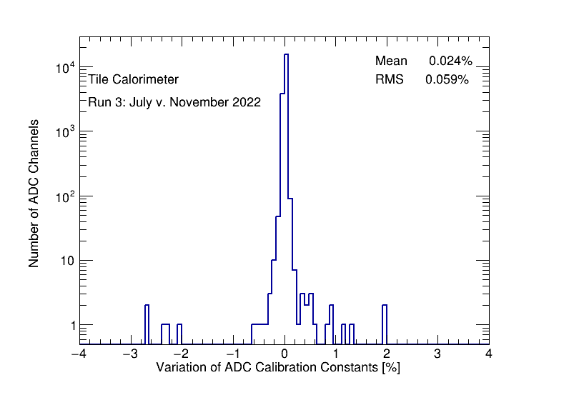
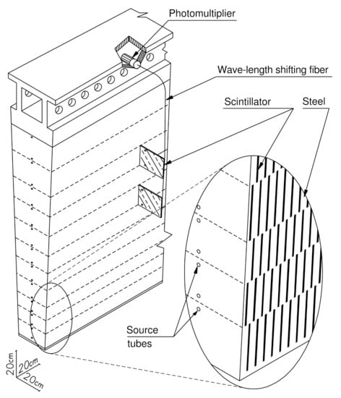
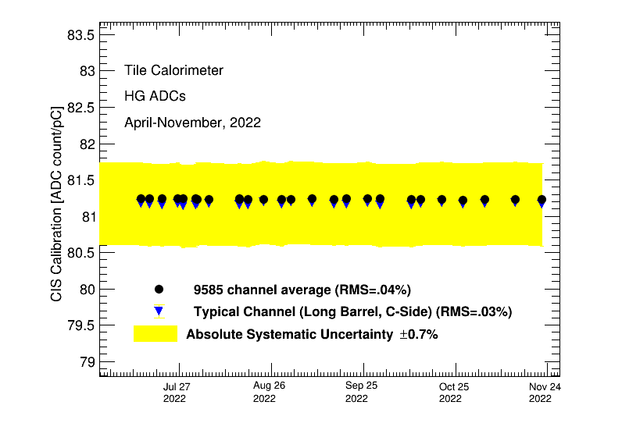
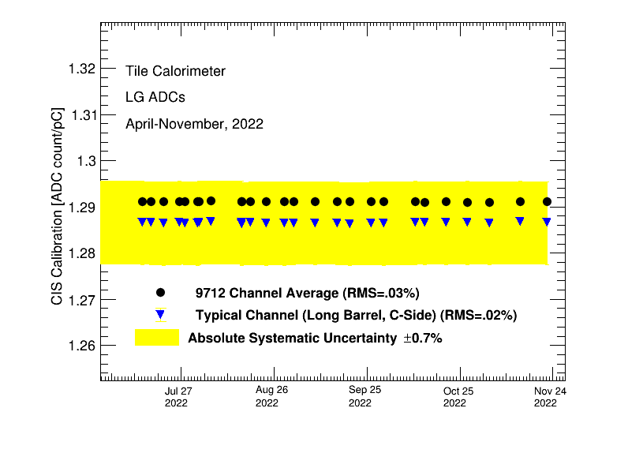
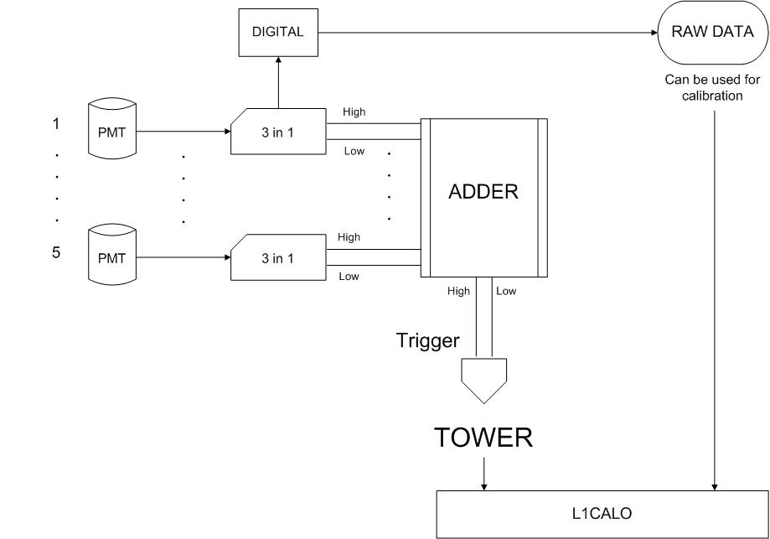
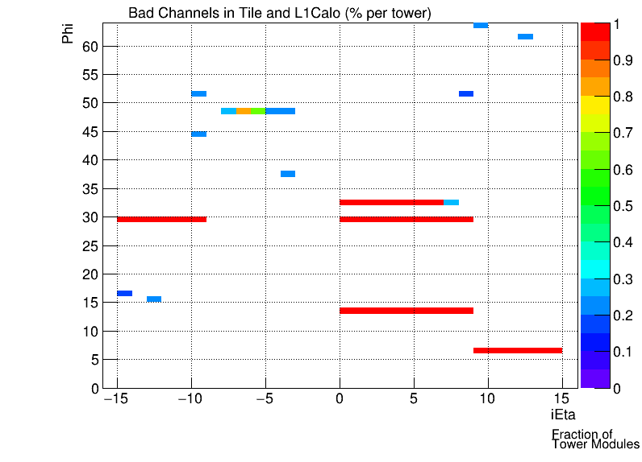
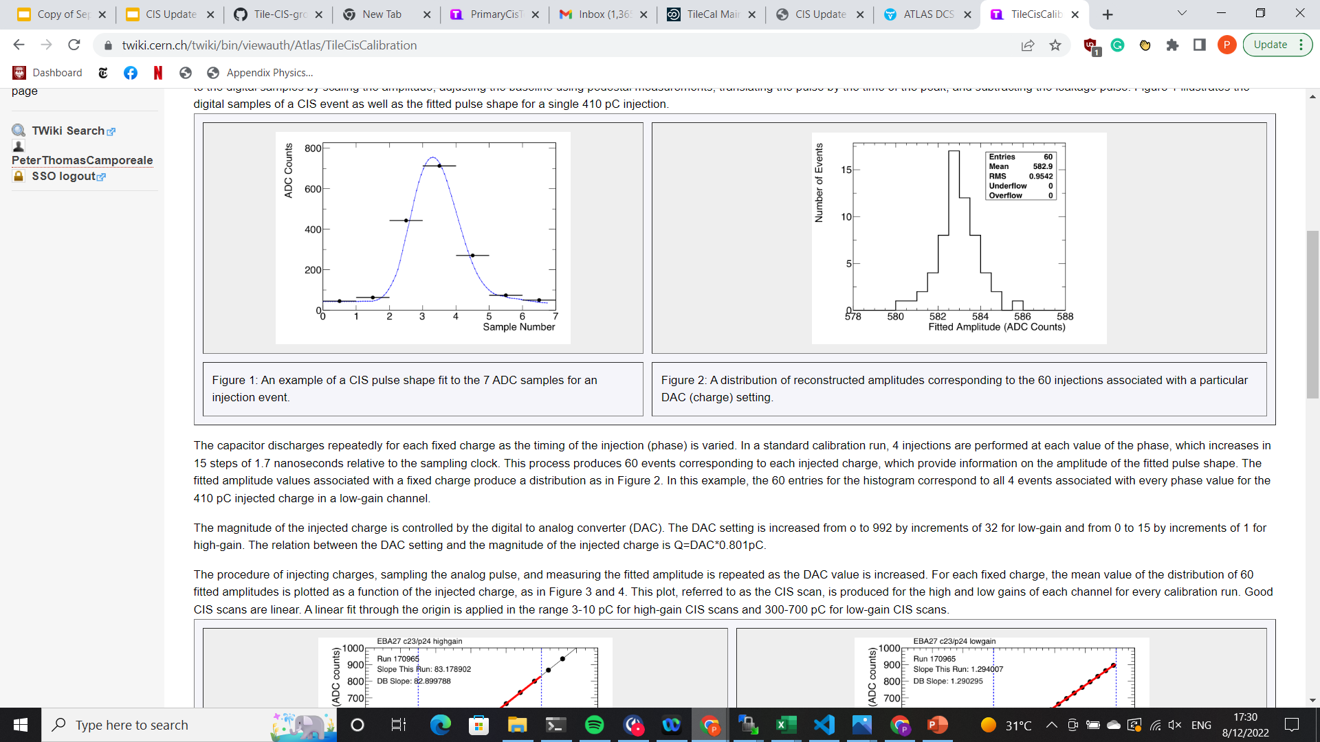
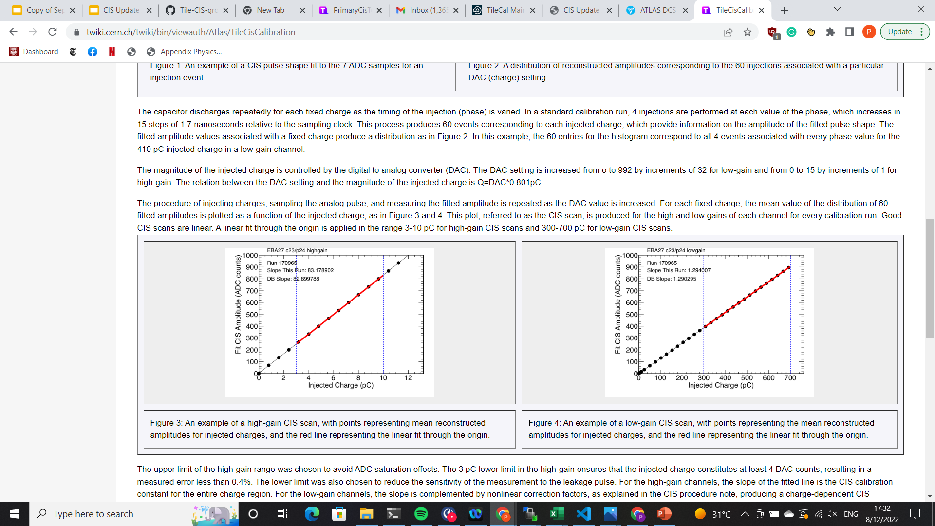
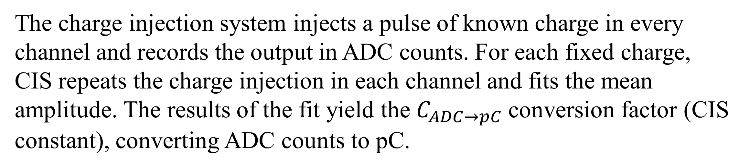
ATLAS Tile Calorimeter Charge Injection System (CIS) and L1Calo
Mengyang Li and Peter Camporeale of The University of Chicago
ATLAS Collaboration Week (February 13-17, 2023)
CIS Constant Stability in Run 3
Introduction
CIS runs are taken 2-3 times per week during data taking and technical stops to monitor the conditions of the Tile electronics.
While instabilities in the electronics can cause shifts of the individual channel calibrations of up to 0.7%, these jumps are rare and are generally corrected within a month. In Run 3 from March to November 2022, we had stable constants in each channel (figure on the right) and the detector as a whole (figures below) over time.
The Tile Calorimeter is a central sampling hadron calorimeter of the ATLAS experiment. It provides information to reconstruct hadrons, jets, taus, missing transverse energy, assists in muon identification and provides inputs to L1 trigger. Light produced by particles going through scintillator is converted into electric charge by the photomultiplier tubes (PMTs). Depending on its value, signal is processed in high or low gain, with ratio of amplification equal to 64:1, respectively. Ten-bit digitizers sample and convert analog signal into digital output at the current LHC rate of bunch crossing (40 MHz).
A cut-away drawing of the ATLAS inner detector and calorimeters. [1]
Number of individual channel percentage change of CIS constant in Run 3 period
A module of the tile calorimeter, with plastic scintillators and steel absorbers. [1]
CIS constant average over Run 3 period from April to November 2022, in High Gain (Left) and Low Gain (Right)
L1Calo and Tile in Run 3
The Level 1 Calorimeter Trigger (L1Calo) uses Tile trigger towers as inputs during data taking. Tile and the L1Calo take combined calibrations to monitor response of trigger towers and compare directly to the response of the electronics. To monitor photomultiplier tubes (PMTs) that contribute to a bad trigger tower, Tile performs PMT scans. To simulate PMT signals, the calibration uses CIS to inject charges to one PMT at a time
Equation of particle energy reconstruction and flow diagram of the TileCal calibration tools: Cesium, Laser, and Charge Injection systems (CIS), and Integrator System readout [2]
CIS Calibration Process
Schematic of PMTs and Trigger Towers in Tile and L1Calo [4]
The charge injection system injects a pulse of known charge in every channel and records the output in ADC counts. For each fixed charge, CIS repeats the charge injection in each channel and fits the mean amplitude. The results of the fit yield the $C_{ADC→pC}$ conversion factor (CIS constant), converting ADC counts to pC.
We identify two types of bad channels: no gain (less than 10% response) and half gain (between 10% and 50% response). We compare these channels to those flagged by L1Calo through other calibrations. Bad channels are marked for possible maintenance interventions during technical stops.
Map of fraction of bad PMT channels per tower in Tile from PMT Scan 441888. Red regions correspond to modules off during the PMT scan.
Analog CIS pulse shape fit to 7 samples (left); fit of mean reconstructed amplitude over a range of injected charges (right) [3]
References: 1. ATLAS Collaboration 2013 Approved Detector Reference Figures And Schematics URL https://twiki.cern.ch/twiki/bin/view/AtlasPublic/ApprovedDetectorReferenceFiguresAndSchematics
2. Calibration and Performance of the ATLAS Tile Calorimeter, Krystsina Petukhova and on behalf of the ATLAS Collaboration 2019 J. Phys.:Conf. Ser. 1390 012107
3. Tile CIS Calibration URL https://twiki.cern.ch/twiki/bin/view/Atlas/TileCisCalibration
4. Tile Trigger Bad Channels URL https://twiki.cern.ch/twiki/bin/viewauth/Atlas/TileTriggerBadChannels

Slide 2
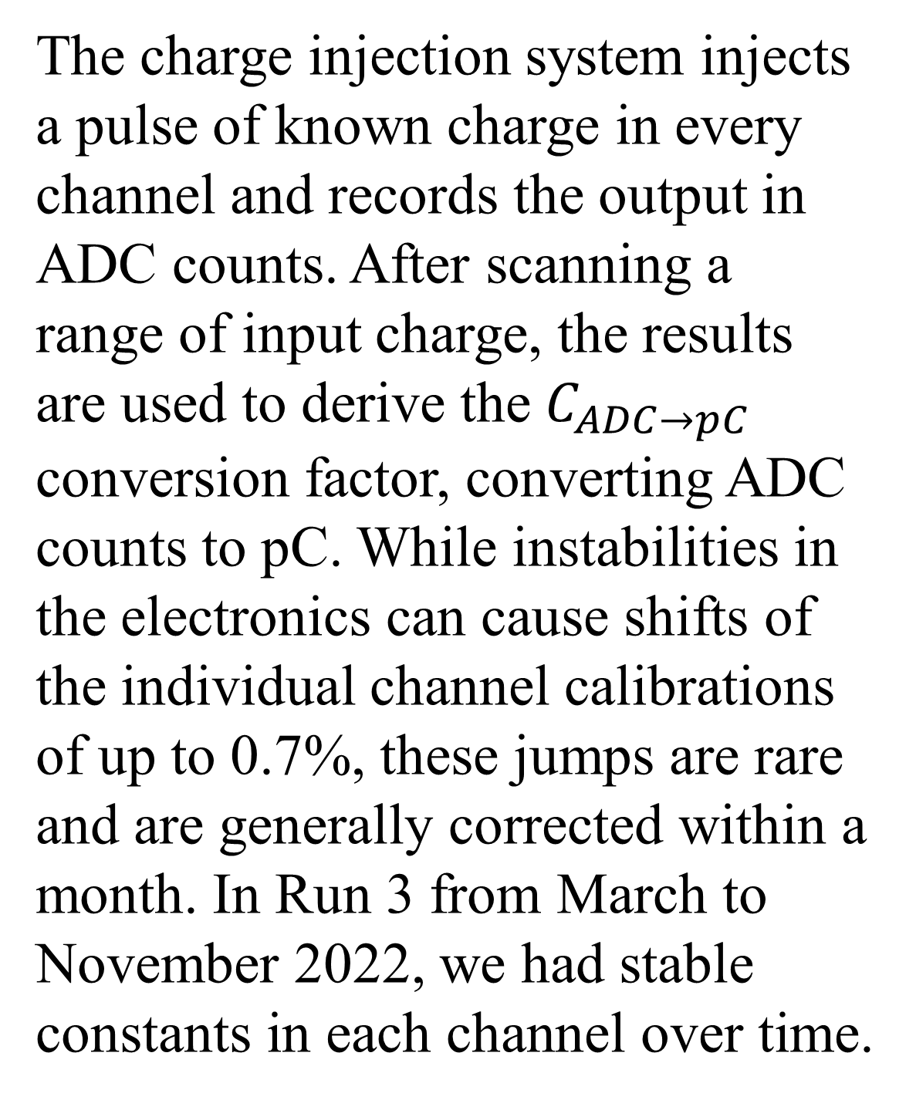
ATLAS Tile Calorimeter Charge Injection System (CIS) and L1Calo
Mengyang Li and Peter Camporeale of The University of Chicago
ATLAS Collaboration Week (Feb 13-17, 2023)
CIS Calibration in Run 3
Introduction
The Tile Calorimeter is a central sampling hadron calorimeter of the ATLAS experiment. It provides information to reconstruct hadrons, jets, taus, missing transverse energy, assists in muon identification and provides inputs to L1 trigger. Light produced by particles going through scintillator is converted into electric charge by the photomultiplier tubes (PMTs). Depending on its value, signal is processed in high or low gain, with ratio of amplification equal to 64:1, respectively. Ten-bit digitizers sample and convert analog signal into digital output at the current LHC rate of bunch crossing (40 MHz).
A cut-away drawing of the ATLAS inner detector and calorimeters. [1]
Analog CIS pulse shape fit to 7 samples (top left); distribution of reconstructed amplitudes of 60 injection events (top right); fit of mean reconstructed amplitude over a range of injected charges (bottom left) [3]
The charge injection system injects a pulse of known charge in every channel and records the output in ADC counts. After scanning a range of input charge, the results are used to derive the $C_{ADC→pC}$ conversion factor, converting ADC counts to pC. While instabilities in the electronics can cause shifts of the individual channel calibrations of up to 0.7%, these jumps are rare and are generally corrected within a month. In Run 3 from March to November 2022, we had stable constants in each channel over time.
A module of the tile calorimeter, with plastic scintillators and steel absorbers. [1]
Number of individual channel percentage change of CIS constant in Run 3 period
Equation of particle energy reconstruction and flow diagram of the TileCal calibration tools: Cesium, Laser, and Charge Injection systems (CIS), and Integrator System readout [2]
CIS Average over Run 3 period from April to November 2022, in High Gain (Left) and Low Gain (Right)
L1Calo and Tile in Run 3
Tile and L1Calo take combined calibrations to monitor response of
trigger towers and compare directly to the response of the electronics. To monitor PMTs that contribute to a bad trigger tower, Tile performs PMT scans. To simulate PMT signals, 100 pF capacitor injects a
charge into the 3-in-1 cards on the motherboards. We then read out
the low gain signal to characterize the response of the electronics.
We define thresholds to characterize the response of PMTs compared
to our expectation given a known injected charge. We identify two types of bad channels: no gain (less than 10% response) and half gain (between 10% and 50% response). We compare these channels to those flagged by L1Calo through other calibrations. Bad channels are marked for possible maintenance interventions during technical stops.
Schematic of PMTs and Trigger Towers in Tile and L1Calo [4]
Map of fraction of bad PMT channels per tower in Tile from PMT Scan 441888.
References: 1. ATLAS Collaboration 2013 Approved Detector Reference Figures And Schematics URL https://twiki.cern.ch/twiki/bin/view/AtlasPublic/ApprovedDetectorReferenceFiguresAndSchematics
2. Calibration and Performance of the ATLAS Tile Calorimeter, Krystsina Petukhova and on behalf of the ATLAS Collaboration 2019 J. Phys.:Conf. Ser. 1390 012107
3. Tile CIS Calibration URL https://twiki.cern.ch/twiki/bin/view/Atlas/TileCisCalibration
4. Tile Trigger Bad Channels URL https://twiki.cern.ch/twiki/bin/viewauth/Atlas/TileTriggerBadChannels

Slide 3
ATLAS Week (Feb 13-17) poster, ATLAS Tile Calorimeter Charge Injection System (CIS) and L1Calo - CERN Document Server
httpscds.cern.chrecord2848703ln=zh_CN

